Slide 1

USCG Community Services Command
Your Exchange and Morale, Well-Being and Recreation Benefits

Slide 2

USCG Community Services Command
Is a FOR BENEFIT enterprise whose efforts are directed at building a system where the Coast Guard's Exchange System and MWR programs, in parity with the other Armed Forces of the United States, continually expand, enhance and deliver highly valuable non-pay compensation programs that are vital in providing for the readiness, retention, and resiliency of those who protect the homeland.

Slide 3
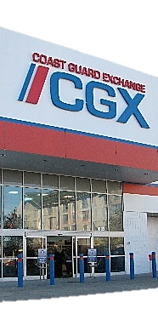


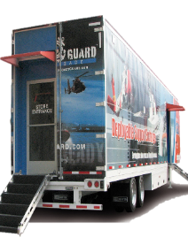

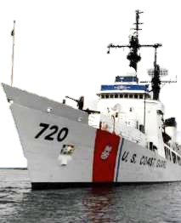
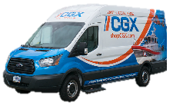


We Are…
CGX
Satellite
Support
MWR
Sports
NAF
Stores
Exchanges
Deployable and Mobile Exchanges
Program Management
Programs
Center of Excellence
3
Notes:
We Are “more than a store”:
Of course, we have the 64 CGX stores
48 Satellite Exchanges on board Coast Guard Cutters
The Deployable Support Exchange and now the Mobile Support Exchange – our “CGX on wheels”
Also, MWR Program Management
The Coast Guard Sports Program
And, the NAF Center of Excellence for the entire US Coast Guard.

Slide 4


Coast Guard Exchange

Slide 5



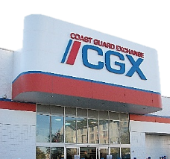

2020 Benefits Delivered
REVENUE
EXPENSE
EARNINGS
BENEFIT
$198 Million
CGX Shopping Benefits
$40 million annual savings
Price parity CONUS and OCONUS
Uniforms sold at cost
100% Tax Free
$184 Million
$145M Merchandise
$15M Operations
$34M Employees
750 NAF Employees increasing costs of:
Benefits
Salaries
$15.2 Million
$2.2 million
MWR Distribution
Contributes $27M/10 yrs.
$9 million
CGX Recapitalization
In the last 5 years, CGX has invested $30 million in stores, infrastructure and IT modernization.
$4.0 million
MWR Recap Fund
CGX FY20 earnings funded $4M in MWR recaps.
$50 per billet
SYSTEM THREATS = APF Funding & APF Billet reductions, Cost of Employee Benefits, Alcohol/Tobacco
5

Slide 6
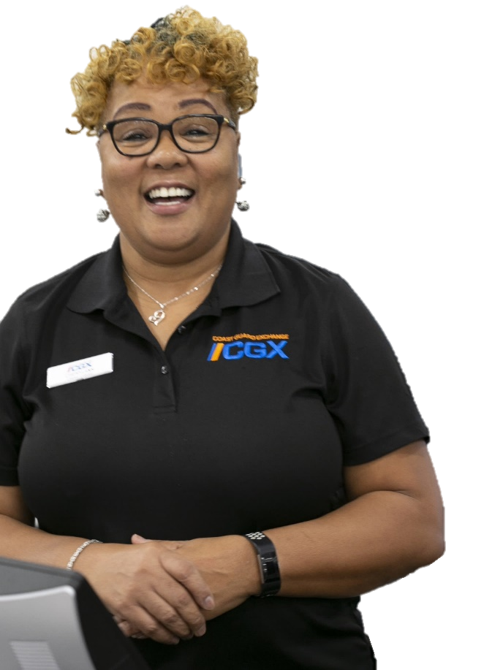
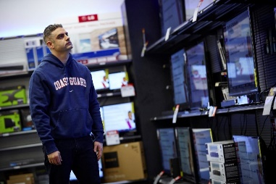
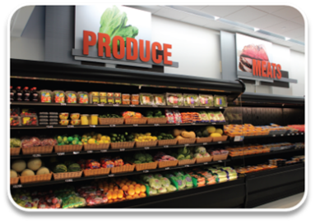
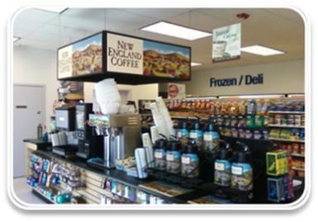
64 Stores in 23 States and Puerto Rico
8 Large Format Stores
2 MarketPlace
54 Convenience
43% Sales
Largest selection of name brand electronics, apparel, home goods & more.
7% of Sales
Groceries, home goods, electronics and apparel.
50% Sales
Convenience locations with grab-and-go snacks and beverages.
20 Stores > 5,000 SQ. FT. 44 Stores < 5,000 SQ. FT.

Slide 7


shopCGX.com
FY20 Sales $6.6M
Top Categories
35K+ items for sale online
New products added continuously
Uniforms
Computers
Gaming
Electronics
TV’s
Coast Guard Logo

Slide 8
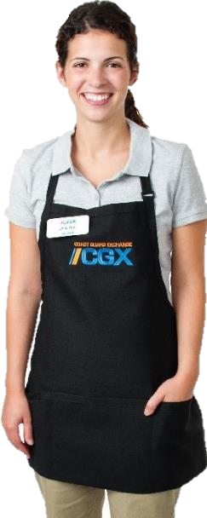



Expanded Patronage
Veteran’s Online
DHS Employees
Disabled
Veterans
MOH, Caretakers, etc.
3 million+ patrons
Full Exchange Privileges
Commissary Privileges
MWR Cat “C” Privileges
18 million patrons Ecommerce only
250,000 patrons Limited privileges

Slide 9
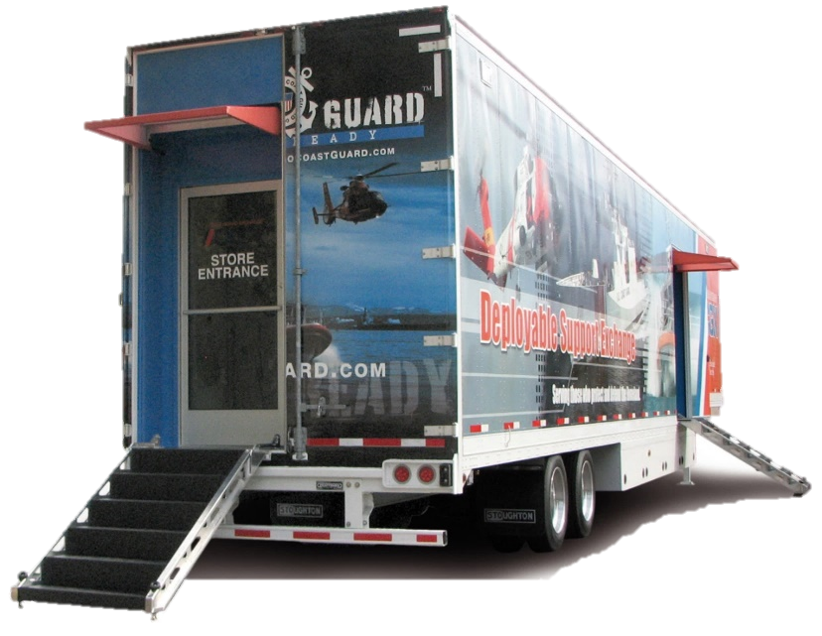
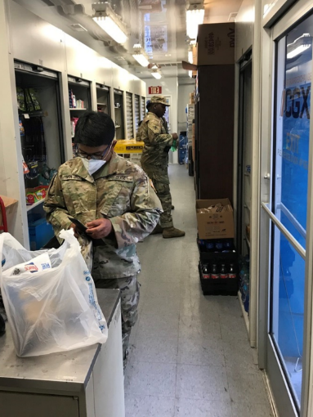
Deployable Support Exchange
29 AUG
31 AUG
1 SEP
2 SEP
3 SEP
Hurricane Ida hits New Orleans.
CGX Michoud reopens.
First shipment of generators arrives.
MSU requests DSE response.
DSE arrives at Terrebonne Emergency Operations Center.
Operational serving responders
on site.
CGX staff arrives to prep and open DSE.

Slide 10
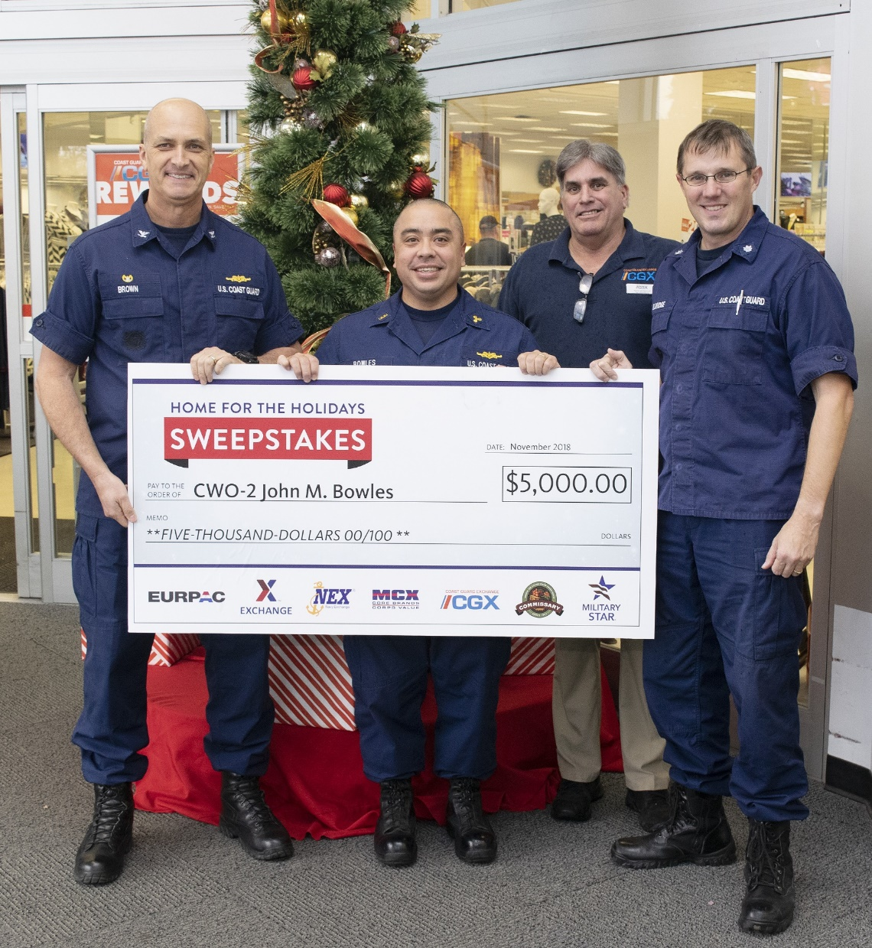
Military Star Card
Annual USCG “Home for the Holidays” sweepstakes winner.
CGX customers receive equal benefits as all service branches.

Slide 11
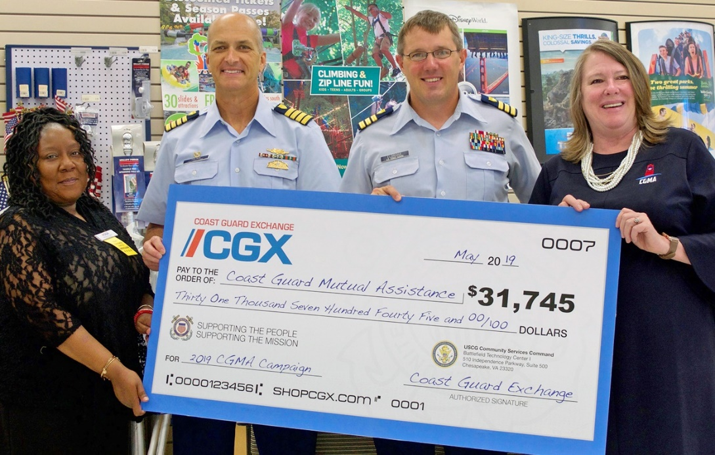
CG Mutual Assistance
In the past ten years, CGX customers gave more than $250K to Coast Guard Mutual Assistance.

Slide 12
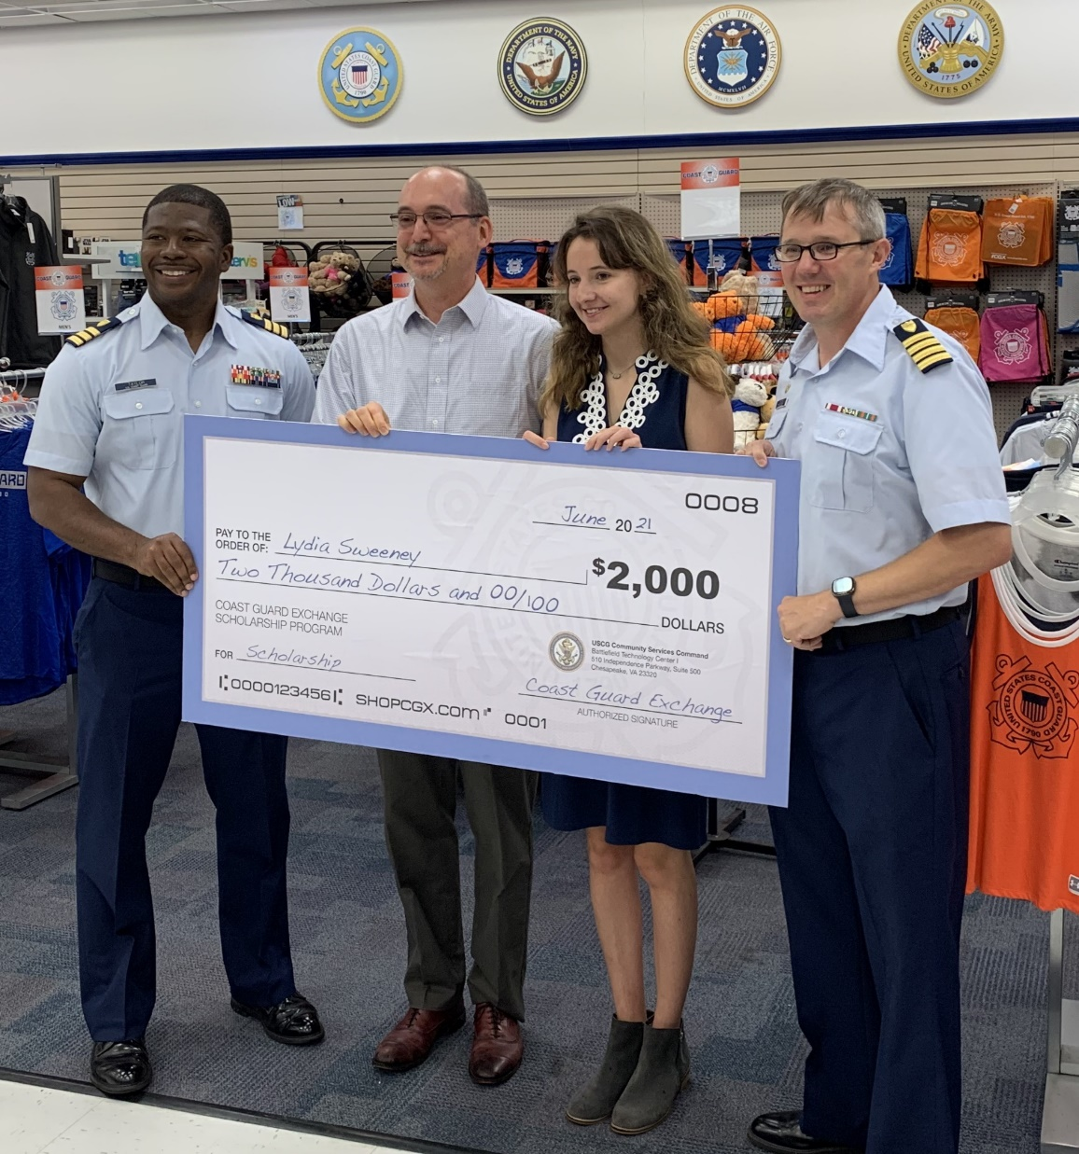
CGX Scholarships
Two $2,000 college scholarships awarded annually to dependent High School graduates.

Slide 13
Veteran’s Day
Limited Edition coin given to all Veteran’s shopping at CGX on November 11.

Slide 14
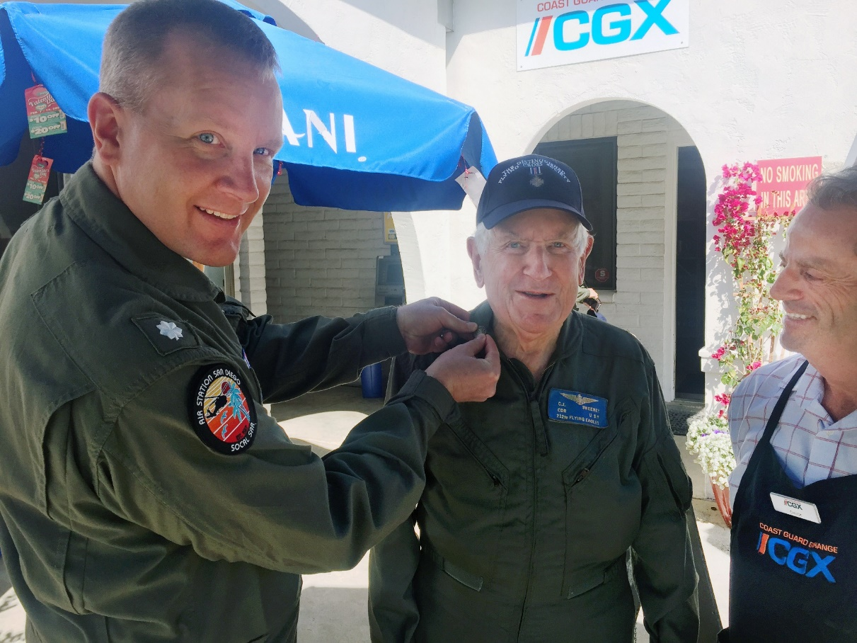

Vietnam Vet’s 50th
Pinning ceremonies to recognize those who served on the 50th Anniversary of the Vietnam War.

Slide 15
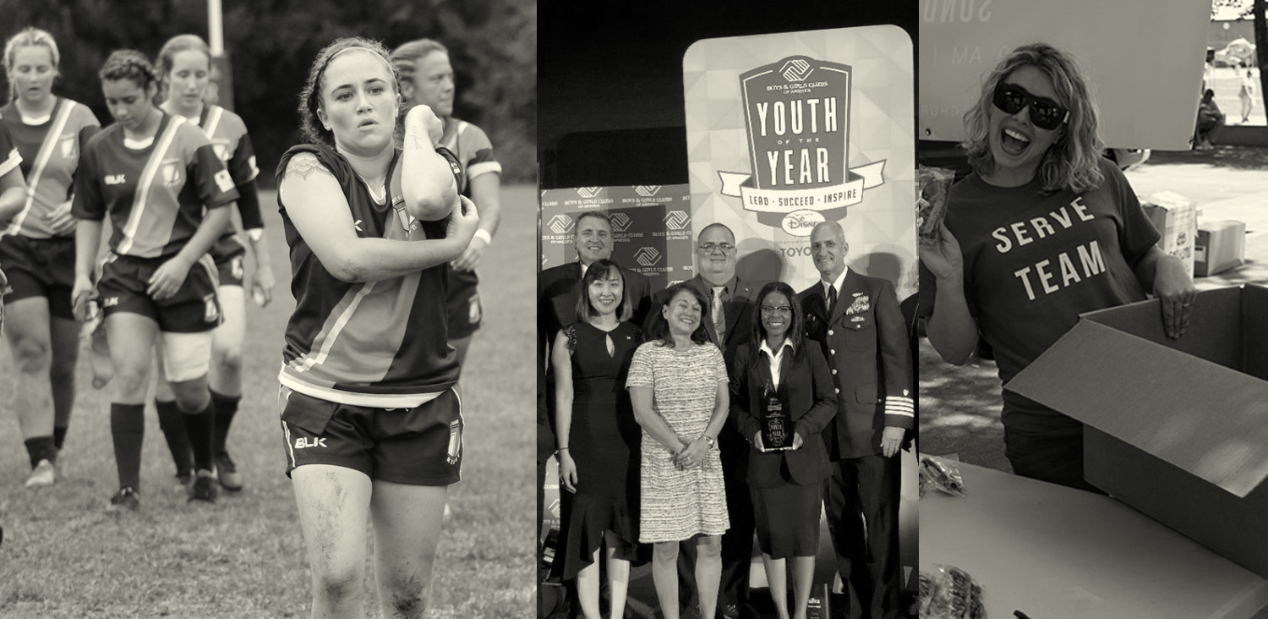

USCG MWR Program

Slide 16
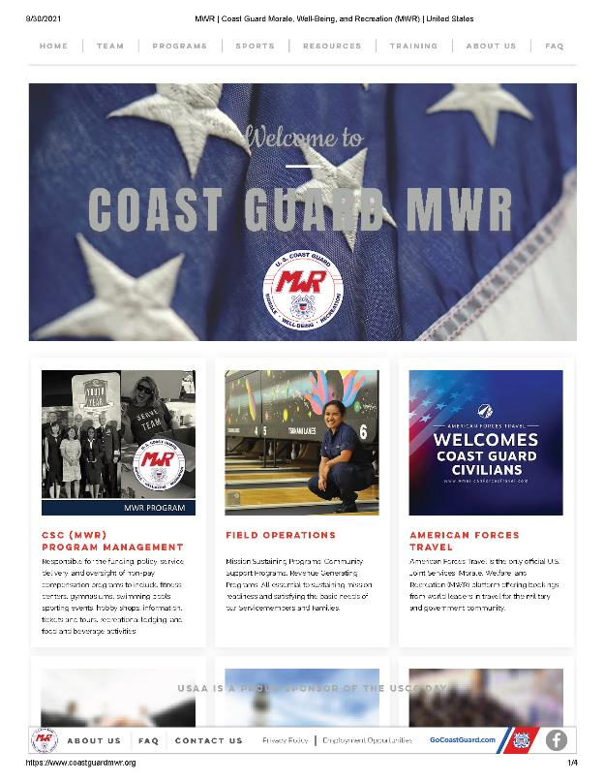
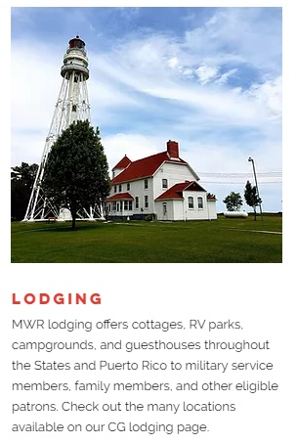
New MWR Website
https://www.coastguardmwr.org/

Slide 17
AmericanForcesTravel.com
Joint Services Leisure Travel Powered by Priceline
Online booking engine for air, cruises, hotel, event tickets, and car rental.
For Active Duty, Reserve, Retirees, Aux, Veterans, and DoD/DHS Civilians

Slide 18
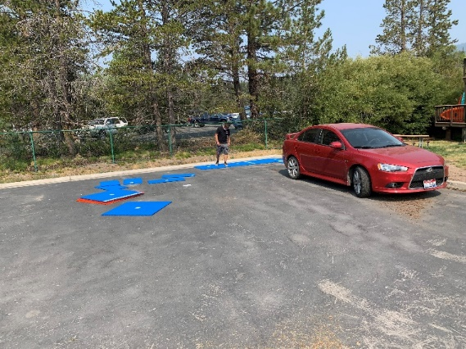
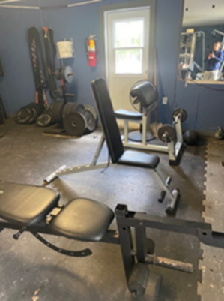
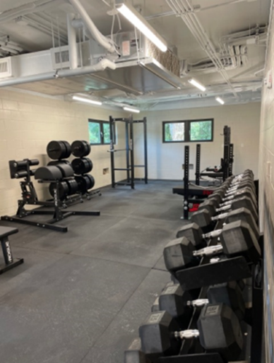
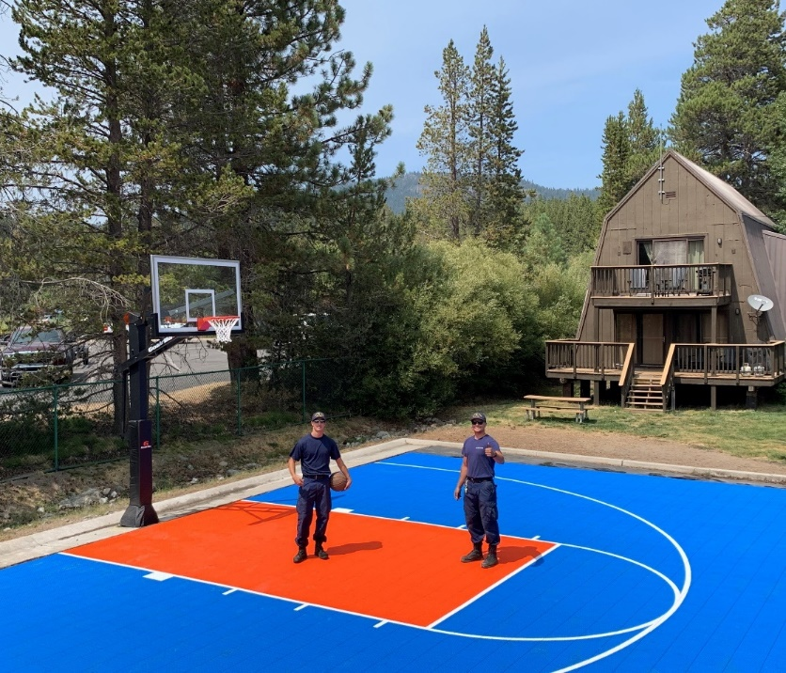
MWR Recapitalization
Investing $4M in MWR facility upgrades and improvements
Before
Before
After
After

Slide 19
In the past 10 years, CGX has contributed more than $27 Million to Coast Guard Morale, Well-Being and Recreation programs.
Notes:
We know our customers have so many choices when they shop. Whether it’s online or in stores, they vote with their dollars and we appreciate every dollar spent at CGX.
As we like to say at CGX, “Put Your Money where your Morale Is,” because the Coast Guard Exchange is the only exchange that contributes to Coast Guard MWR programs. So when you shop here, your not only saving money and taxes, you’re “paying it forward” to the members of the Coast Guard family who enjoy the non-pay compensation benefits of the Coast Guard MWR programs.

